Slide 1
Sketchers 2011
Recognition Team
Calvin Loncaric, Jessi Peck, Miranda Parker

Slide 2
Our Goals for the Summer
Improve overall recognition
Improve adaptive recognition so the program will change according to the user
Training the code better
Better refining after the recognition has occurred

Slide 3
The State of the Code
The 2010 Process of Recognition
TestRig
WEKA Implementation
Notes:
Maybe add some pretty pictures of logic circuits or just gates! That would be awesome if that could be the background…

Slide 4
Recognition Process
When the Recognition button is hit, it begins calling functions from the RecognitionManager
ClassifySingleStrokes
GroupStrokes
Recognize
ConnectSketch
RefineSketch
The circuit itself is then recognized in order to be simulated

Slide 5
ClassifySingleStrokes
Calls strokeClassifier.Classify
Classify uses decision trees to determine each substroke’s classification
A substroke is part of a stroke
A decision tree is a series of “questions” that will eventually lead the program to the “best” choice
Ensures that each substroke belongs to its parent shape’s type
If a substroke is part of an AND gate, the substroke is classified as a Gate
Notes:
DEFINE DECISION TREE

Slide 6
GroupStrokes
Calls strokegrouper.GroupSketch
GroupSketch uses decision trees and each substroke’s classification
Makes shapes by merging strokes that are classified as joined
makeShapes calls Sketch.mergeShapes, which merges the two shapes given as arguments into one shape

Slide 7
Recognize
Calls Recognizer.RecognizeSketch
Calls RecognizeShape for each shape in the sketch
Calls WireRecognizer.Recognize if it’s a wire
Returns “wire” with 100% confidence
Calls TextRecongizer.Recognize
Calls MicrosoftInk and a word list to parse the label
Calls ComboGateRecognizer.Recognize
Follows an intricate process with 4 recognizers
Notes:
Explain MicrosoftInk??

Slide 8
ComboRecognizer
Uses a Naïve Bayesian Classifier to recognize a shape
Uses the number of strokes in the shape
Uses the top 5 results from the ImageRecognizer
Uses results from RubineRecognizer
Uses results from DollarRecognizer
Uses results from ZernikeMomentRecognizer
Notes:
Define Naïve Bayesian Classifier? Define Recognizers?
Dollar Recognizer using average templates?

Slide 9
ConnectShapes
Calls ConnectShapes.Clear
Gets the dictionary of connected shapes and their connection type
Removes all keys and values
Calls ConnectShape
Updates the connections of the given shape
Calls OrientShape
Updates the orientation of the given shape
Notes:
What’s connections? What’s orientation?

Slide 10
RefineSketch
Calls ContextRefine
If a shape is out of context, it is given it’s next most likely context
If a NOT gate is connected to three wires, it’s reassigned a shape
Calls RefineWires
Merges any wires that should be part of the same shape
Calls MakeShapeNamesUnique
Makes sure every shape in the sketch has a unique name
Examples of shape names: ‘A’, ‘Wire0’, ‘And1’
Notes:
ContextRefine refines it three times, just in case
DEFINE UNIQUE?

Slide 11
TestRig
In a nutshell, TestRig loads in a bunch of files and then runs some set of code modules on the files
Easy to create code module from the abstract class ProcessStage, which only requires two methods to be written

Slide 12
TestRig Before
Ran on 5 stages that ran simply on outdated methods
GroupStage
FragmentStage
SymbolStage
LabelStage
AllStage

Slide 13
TestRig Now
Runs on 5 stages through the RecognitionManager, so as those methods change, TestRig changes with them
GroupStage
ClassifyStage
SymbolStage
ErrorCorrectionStage
SuccessiveCorrectionPhase
Results for ClassifyStage: 89% Correct
Results for GroupStage: 77% Correct
Results for SymbolStage: 35% Correct*
* This may be due to errors in SymbolStage instead of errors in Recognizer

Slide 14
What Is WEKA?
Waikato Environment for Knowledge Analysis
Machine learning software written in Java
Suite of tools for data analysis and predictive modeling
Developed by the University of Waikato, New Zeland

Slide 15
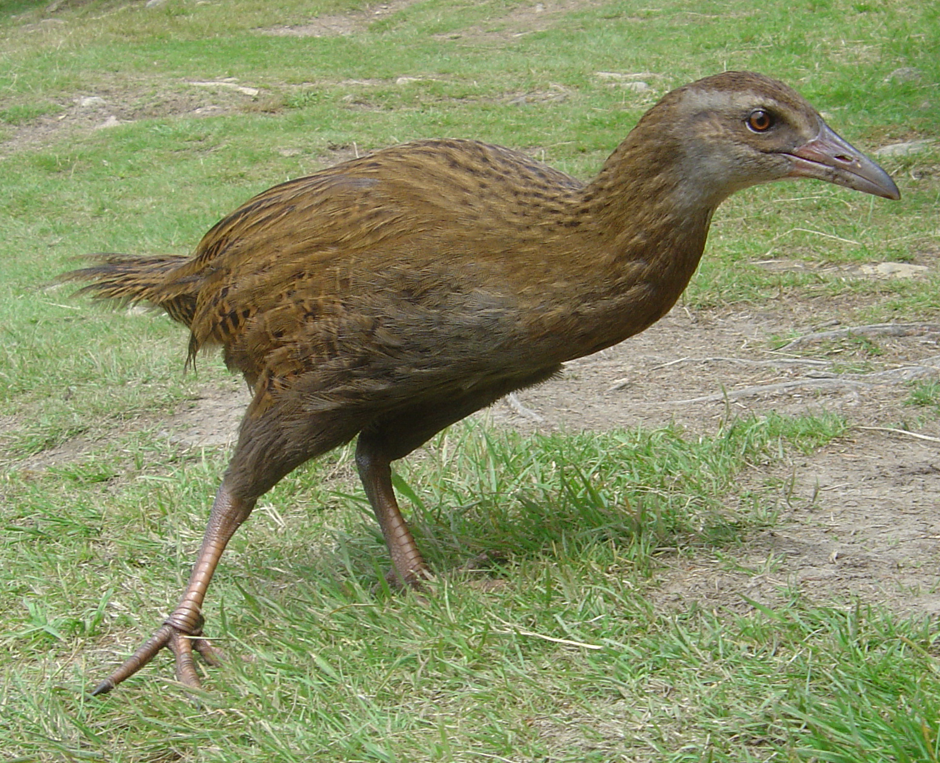

Slide 16
From Decision Trees to WEKA
Last summer, the code was adapted to use decision trees to avoid reliance on WEKA
WEKA was more accurate, but the decision trees were significantly more efficient
Our goal is to find a efficient way to implement WEKA
IKVM allowed us to create a weka.dll file that had all of the functionality of the WEKA environment and could be run without reliance on Java

Slide 17
WEKA Implementation
WEKA is slower than decision trees but can be more accurate once it has been trained on the proper data files
Currently, StrokeGrouper and StrokeClassifier have been changed to use WEKA
However, the current implementation is less accurate than the decision trees were
In order to train the classes, the data in XML files need to be converted to ARFF files

Slide 18
Future Work
Continue improving TestRig
Utilize WEKA to improve StrokeClassifier and StrokeGrouper
Work with ComboRecognizer to improve the Bayes Classifier
Train each recognizer so as to better adapt to each user’s needs and drawing style
Improve Refine by using the results we get from TestRig about misclassifications

